Slide 1
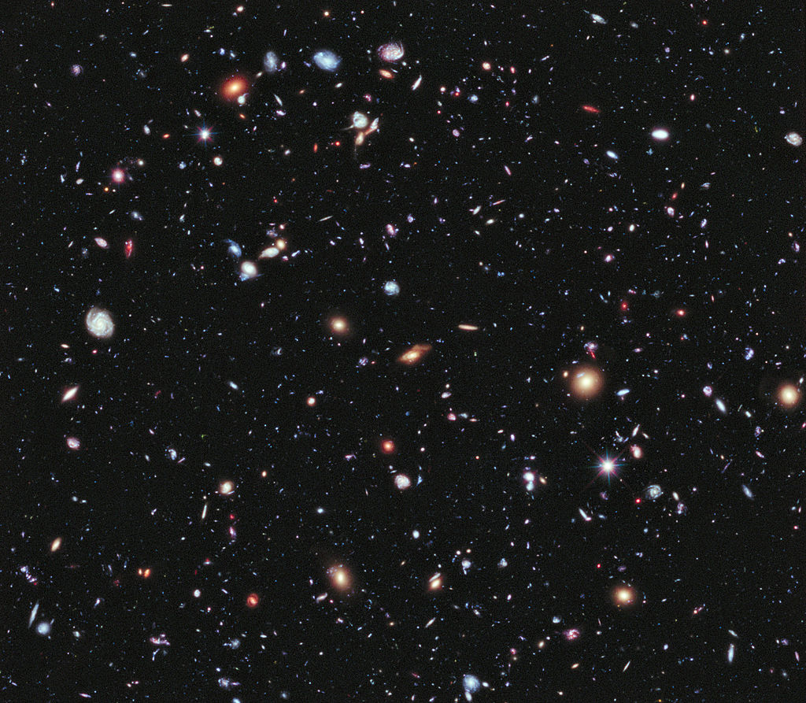
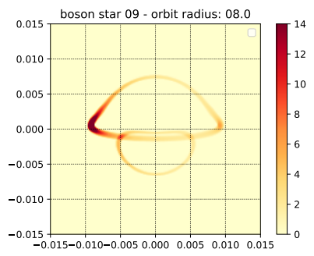
Modelling a bosonic star at the galactic centre with GYOTO
João Luís Rosa
Spanish-Portuguese Relativity Meeting 2021, Aveiro, Portugal
In collaboration with:
Vítor Cardoso, Paulo Garcia, Frederic Vincent

Slide 2
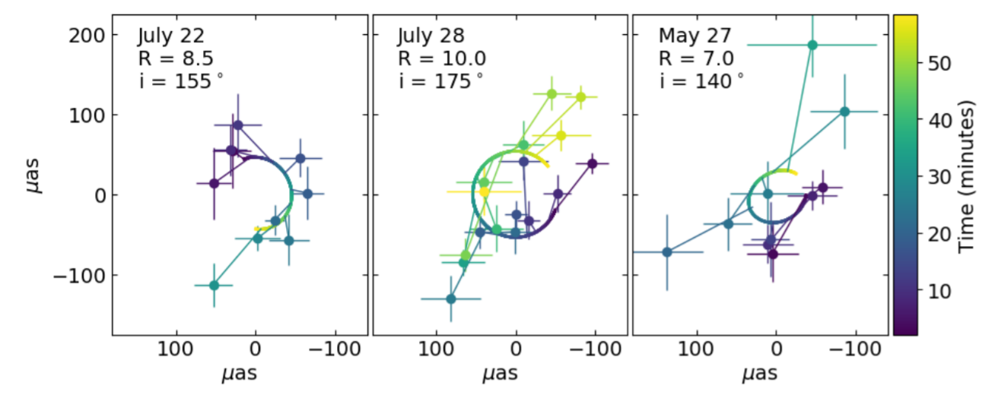
MOTIVATION
Recent observations indicate that objects which behave like black-holes exist
S2 Star orbit
ESO (2016)
M87 BH Shadow
EHT (2019)
Flares!
ESO (2020)
A&A 635, A143 (2020)
Modelling a bosonic star at the galactic centre 1/7

Slide 3
FRAMEWORK
Einstein-Klein-Gordon theory: addition of a complex and massive scalar field.
Einstein-Proca theory: addition of a complex and massive vector field.
Look for solutions with the following characteristics:
Spherically symmetric
Localized bosonic fields
Modelling a bosonic star at the galactic centre 2/7

Slide 4
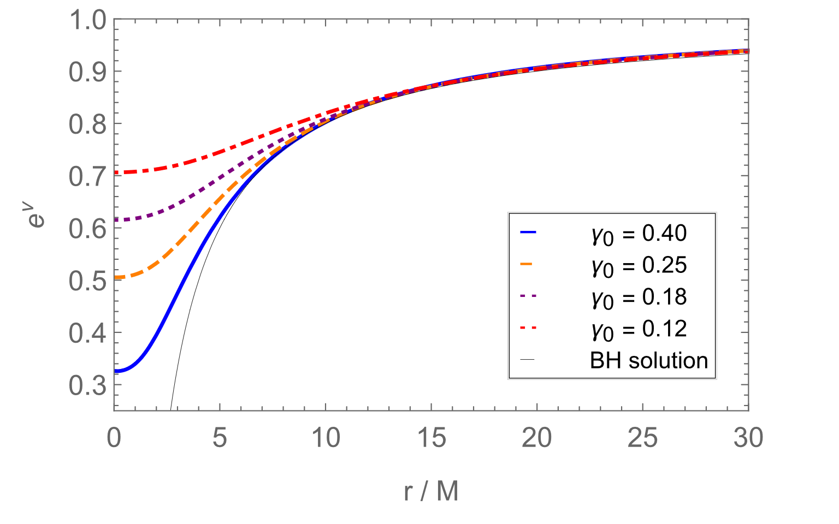
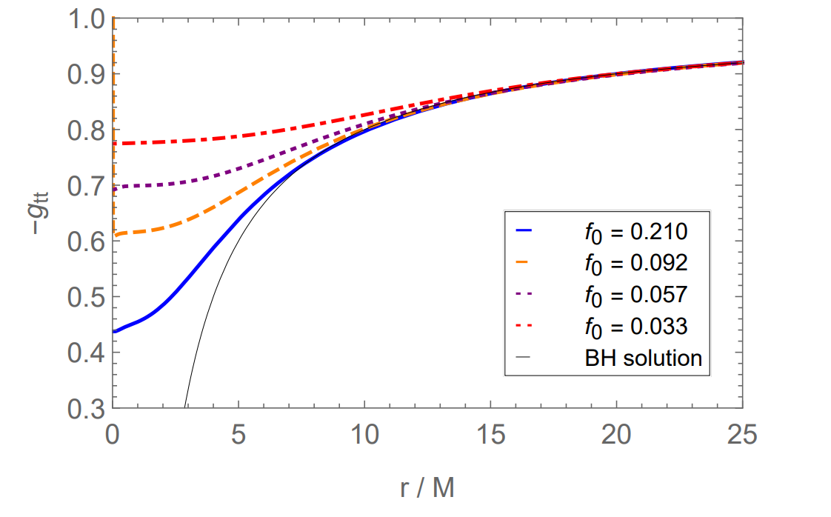
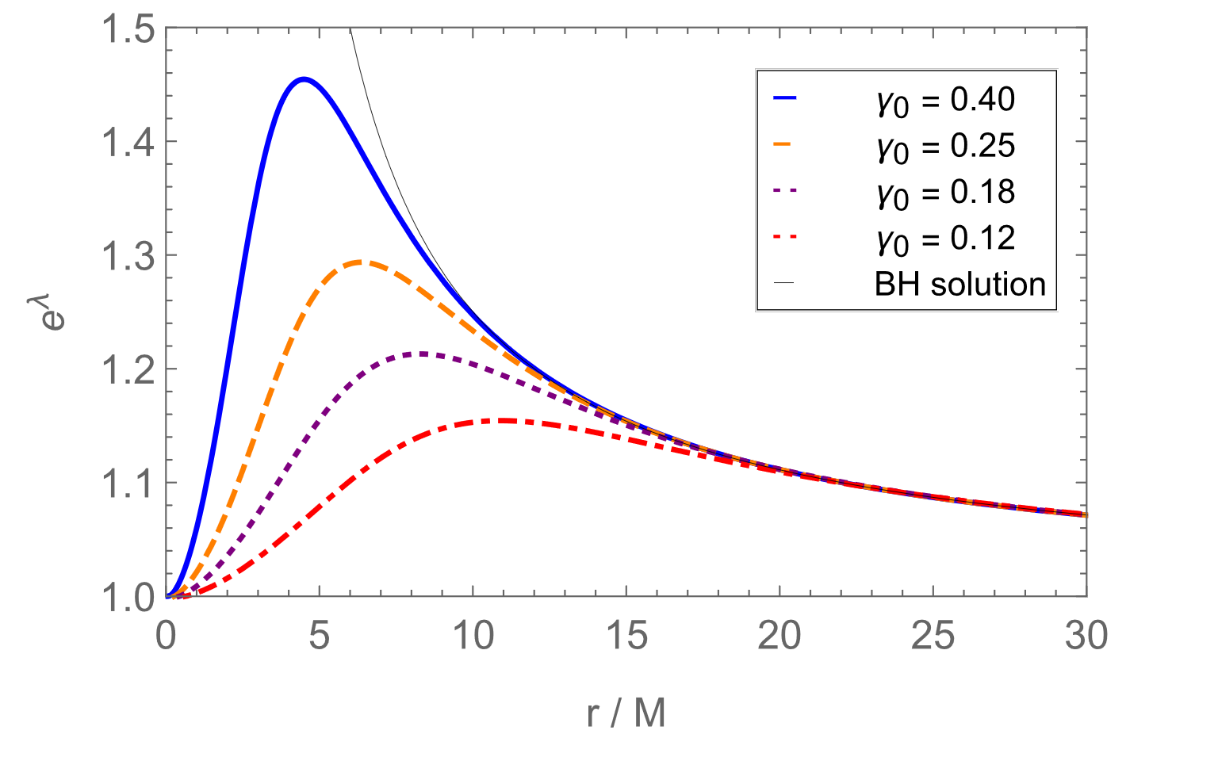
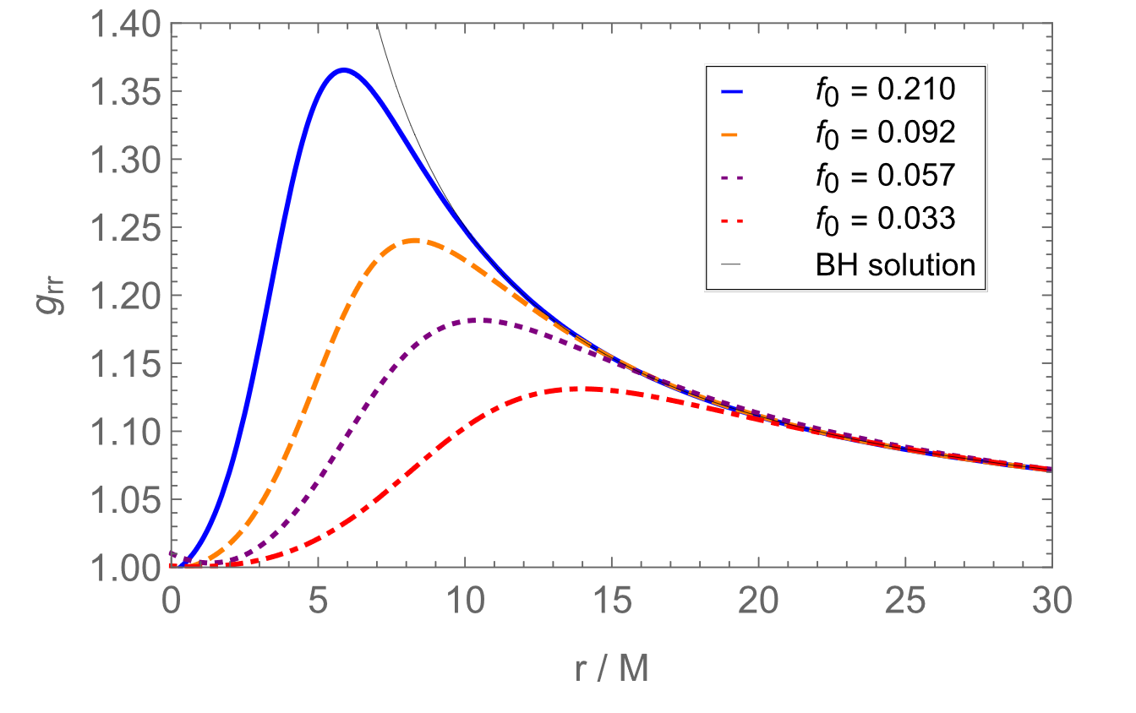
SPACETIME METRICS
Boson star
Proca star
Modelling a bosonic star at the galactic centre 3/7

Slide 5
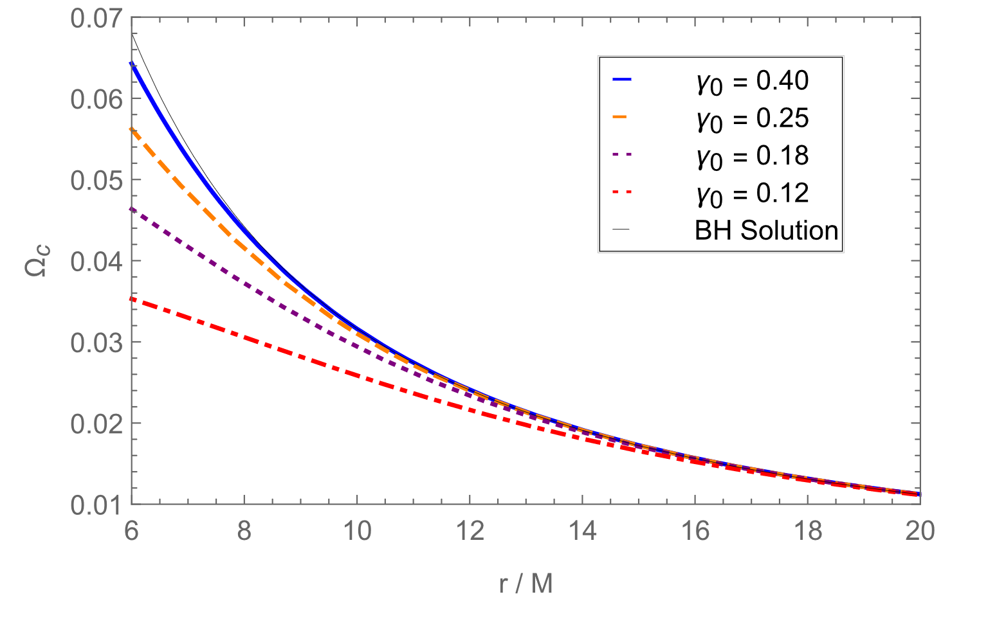
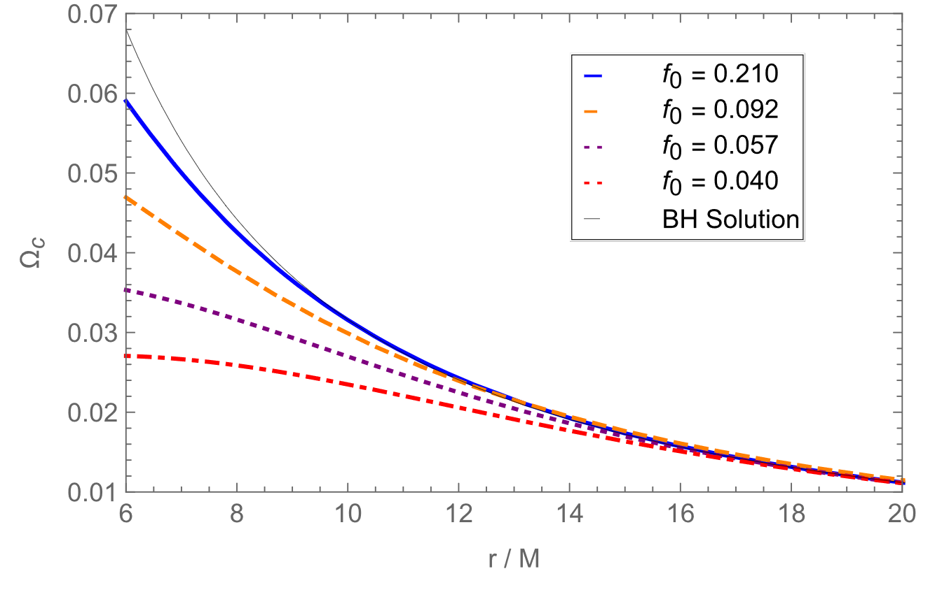
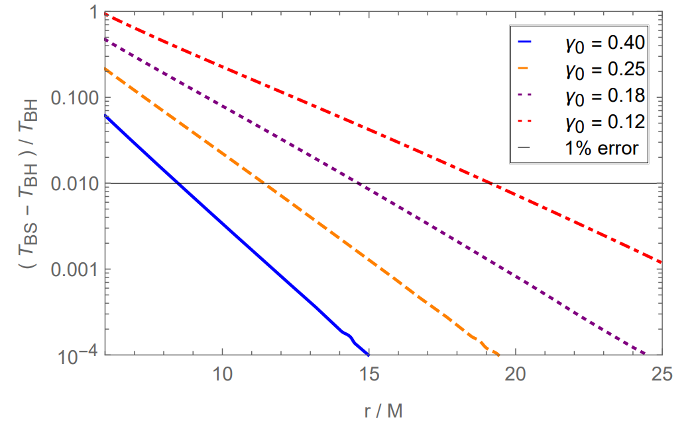
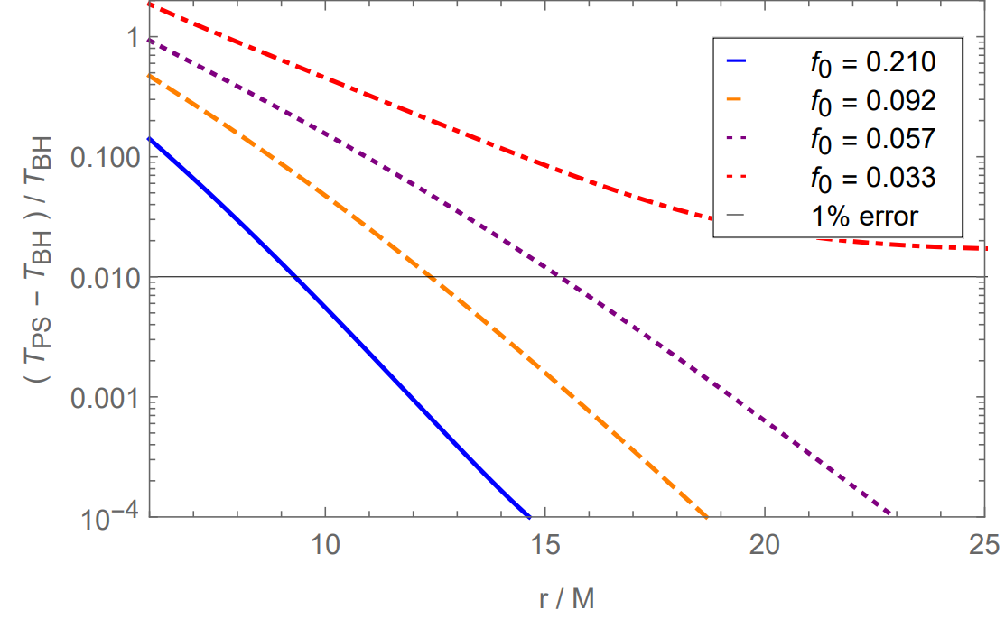
ORBITAL MOTION
Boson star
Proca star
Modelling a bosonic star at the galactic centre 4/7

Slide 6
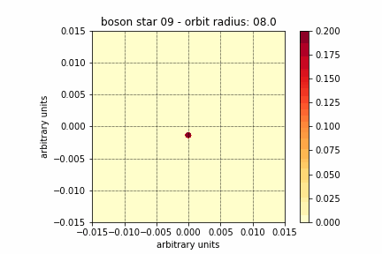
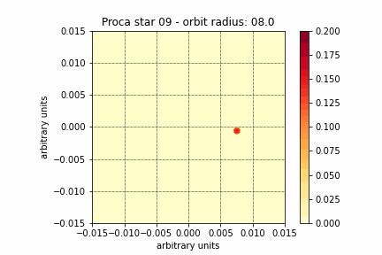
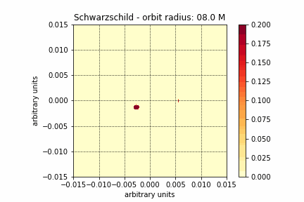
EXAMPLES OF ORBITS
Main differences:
Apparition of third image
Different image shapes
Different flux intensities
Different deflection angles
Modelling a bosonic star at the galactic centre 5/7

Slide 7
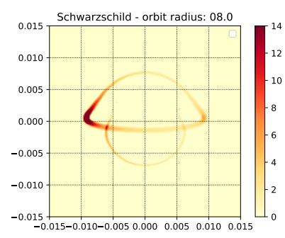
INTEGRATED FLUX
Modelling a bosonic star at the galactic centre 6/7

Slide 8
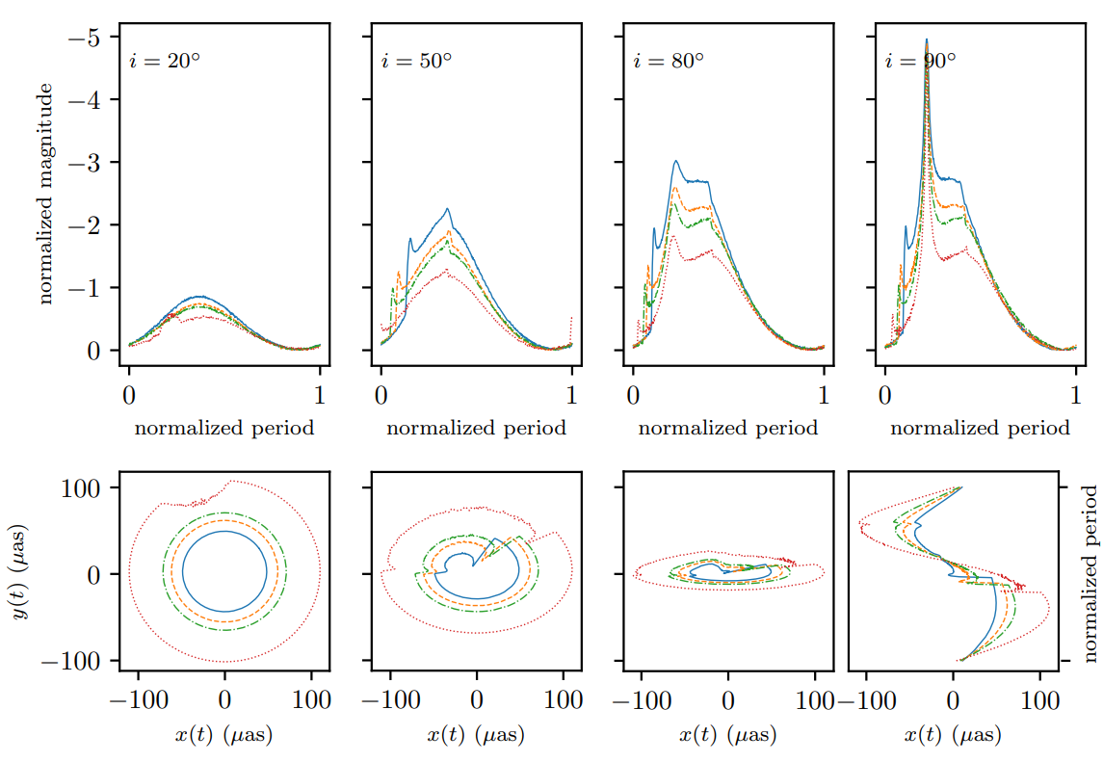
MAGNITUDE AND CENTROID
Modelling a bosonic star at the galactic centre 7/7

Slide 9
ONGOING WORK
1. Comparison of models with experimental data;
(orbital period, centroid, flux)
2. Impose constraints on the masses of the stars;
3. Impose constraints on the masses of the fields;
4. Test validity of Newtonian approximations;
THANK YOU FOR YOUR ATTENTION

